Slide 1
READY FOR WORK AFTER COVID-19:
How Can Our Workforce Development Systems Prepare Coloradans for a Post-COVID Economy? June 17, 2021
Presented by: Laura Ware and Charlie Brennan Colorado Center on Law and Policy
Special Comments by: Katherine Keegan Office of the Future of Work, Department of Labor and Employment
Clarke Becker Colorado Workforce System Rural Consortium, Department of Labor and Employment

Slide 2
WELCOME!
Introduction with Katherine Keegan
Project Overview
Comments on Rural Colorado with Clarke Becker
Colorado Before and During COVID-19
Opportunities of Interest
Promising Practices
Recommendations
Next Steps
Feel free to add questions/comments to the Q&A/chat at any time!
Notes:
Laura Overview and Intro Katherine - 2 min - 3:02

Slide 3
INTRODUCTION OF PROJECT
KATHERINE KEEGAN Director, Office of the Future of Work
Notes:
Katherine - 5 min - 3:07

Slide 4
OVERVIEW OF PROJECT
Focused on reasons for long-term unemployment and efforts related to unemployment caused and affected by COVID-19
Significant research into how different training and credential options have been pursued, by which unemployed workers, and in which regions
Diverse conversations had with policy-makers, legislators, community organizations and impacted Coloradans about potential opportunities being developed
Groups of unemployed workers impacted by the pandemic were also interviewed
Notes:
Charlie slides 4 and 5 - 2 min
Thanks Katherine for that introduction, we really appreciate you joining us this afternoon. Now I’d like to give an overview of the project for those who are not familiar. We began this project in the spring of last year, it was funded by the ECMC Foundation. For the project we wanted to understand the experiences unemployed Coloradans during the pandemic, as well as the changes and shifts in Colorado’s job market that resulted from the public health restriction on the economy. We conducted by quantitative and qualitative research. For the qualitative research, we interviewed a number of key stakeholders across the state from a range of sectors related to workforce development, training, and adult education. Our interviews included focus groups with unemployed Coloradans.

Slide 5
OVERVIEW OF PROJECT
Results and recommendations will be presented to stakeholders in June, comments incorporated into final report
Final report completed by mid-July
Notes:
Charlie - cont - through 3:09
We are in the process of compiling the results into a summary report which we hope to release in the coming weeks, by mid-July. This presentation is just a preview of the findings and recommendations, and we hope to be able to take the comments and feedback we hear from you all today and incorporate that into the final report.

Slide 6
PARTNERS
Colorado Department of Labor and Employment
Office of the Future of Work: focused on work opportunities and dynamics that will impact Colorado workers of many types
Colorado Rural Workforce Consortium: includes network of 10 workforce sub-areas, representing 51 rural counties across the state
Adult Employment Services and Workforce Areas: oversees workforce programs, including Rural Consortium and 8 additional workforce areas
Skills 2 Compete Coalition
Colorado branch of National Skills Coalition; diverse membership ultimately advocates for skills training of all types needed by adults
Support Services Committee: comprised of organizations, agencies, advocates, and interested citizens who are concerned about supportive services that lead to achievement of vocational goals
Notes:
Laura - describe partners - 2 min - 3:11

Slide 7
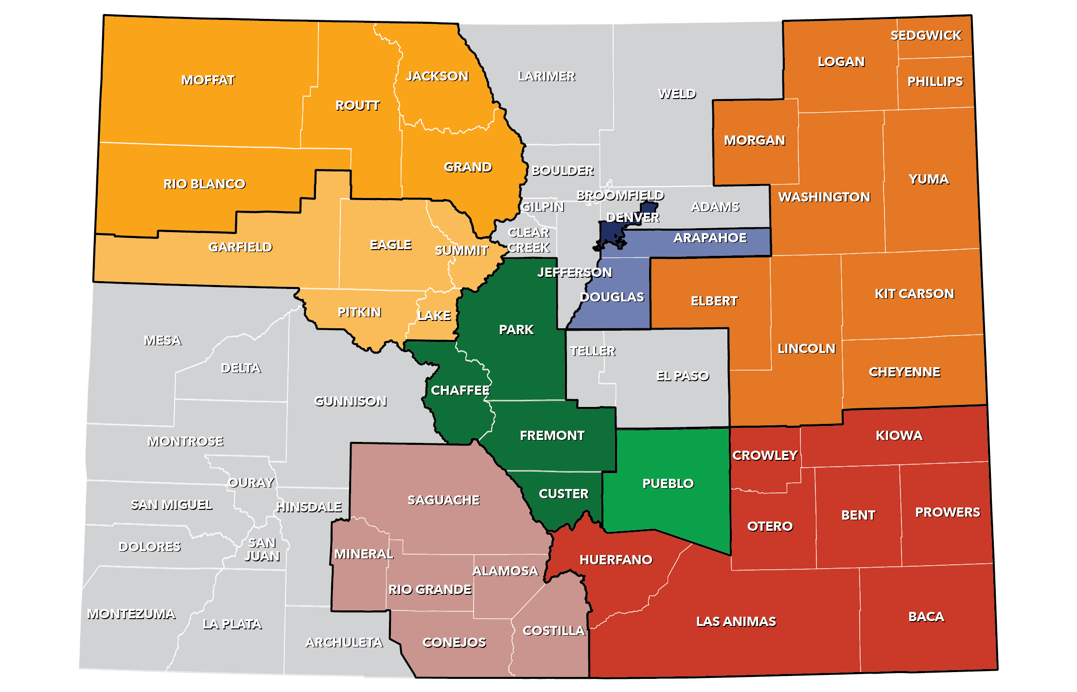
REGIONS
EASTERN
Population 25 to 54: 37.0%
Share Non-White: 22.9%
Share HS or Less: 42.8%
Limited English HHs: 2.9%
HHs With Broadband: 56.5%
NORTHWEST
Population 25 to 54: 40.8%
Share Non-White: 12.1%
Share HS or Less: 33.6%
Limited English HHs: 1.2%
HHs With Broadband: 65.1%
DENVER
Population 25 to 54: 50.5%
Share Non-White: 41.5%
Share HS or Less: 27.5%
Limited English HHs: 4.6%
HHs With Broadband: 74.7%
RURAL RESORT
Population 25 to 54: 45.0%
Share Non-White: 24.1%
Share HS or Less: 32.3%
Limited English HHs: 5.0%
HHs With Broadband: 63.0%
ARAPAHOE/DOUGLAS
Population 25 to 54: 42.7%
Share Non-White: 29.7%
Share HS or Less: 22.7%
Limited English HHs: 3.2%
HHs With Broadband: 82.2%
UPPER ARKANSAS
Population 25 to 54: 38.8%
Share Non-White: 17.1%
Share HS or Less: 43.7%
Limited English HHs: 0.5%
HHs With Broadband: 58.2%
SOUTH-CENTRAL
Population 25 to 54: 33.4%
Share Non-White: 49.0%
Share HS or Less: 42.9%
Limited English HHs: 5.8%
HHs With Broadband: 44.4%
PUEBLO
Population 25 to 54: 36.7%
Share Non-White: 44.8%
Share HS or Less: 38.3%
Limited English HHs: 1.3%
HHs With Broadband: 62.1%
SOUTHEAST
Population 25 to 54: 34.8%
Share Non-White: 38.6%
Share HS or Less: 45.9%
Limited English HHs: 2.7%
HHs With Broadband: 47.6%
Source: 2019 5-Year American Community Survey
Notes:
Charlie - 2 min - 3:13
We know that the economic conditions in our state vary by region, most times statewide statistics mask variations between urban and rural Colorado generally, as well as variations between regions. For this reason, we chose these 9 workforce development areas and subareas to understand how the economic impacts of COVID-19 differed across Colorado. We've provided some statistics from 2019 just to give a sense of how these regions were similar and different from one another. We also targeted our stakeholder interviews to include stakeholders from these regions.
Introduce Clarke:
Now, I'd like to introduce our next speaker, Clarke Becker, who will give us an overview how the experiences of rural Colorado differed from urban parts of the state over the past year, as well as the outlook for economic recovery and growth moving forward in rural Colorado. Clarke is the director of the Colorado Workforce Rural Consortium and oversees workforce development areas that represent 51 of our 64 counties. In addition to this, Clarke has served as an elected official in multiple local governments in rural parts of Colorado which adds a unique perspective to his tremendous understanding of rural Colorado and the challenges and opportunities facing rural communities. Laura and I always come away from our conversations with Clarke having learned something new or seeing an issue from a perspective we hadn’t considered before so we are very excited and appreciative that he was able to join us today.

Slide 8
COMMENTS ON RURAL COLORADO
CLARKE BECKER Director, Colorado Rural Workforce Consortium
Notes:
Clarke - high points re: Colorado 5 min
3:18

Slide 9
COLORADO BEFORE & DURING COVID-19
A Look at Two Regions:
Rural Resort Region
Highest rate of unemployment in April 2020
Eastern Region
Lowest rate of unemployment in April 2020
Notes:
Charlie - introduce 1st two regions 1 min
3:19 - 3:20
Thank you Clarke for that overview. I'd like to now look specifically at two regions that were included in our project: the Rural Resort and Eastern regions. We chose these regions because they had the highest and lowest unemployment rates, respectively, in April 2020, the month where job losses and unemployment peaked in our state.
Before we dive into the regions, I first wanted to ask you all to be thinking of your experiences over the past 15 months in your regions, organizations and agencies. Please feel free to include those in the chat, as we plan to share out some of what you share with us to the group.

Slide 10
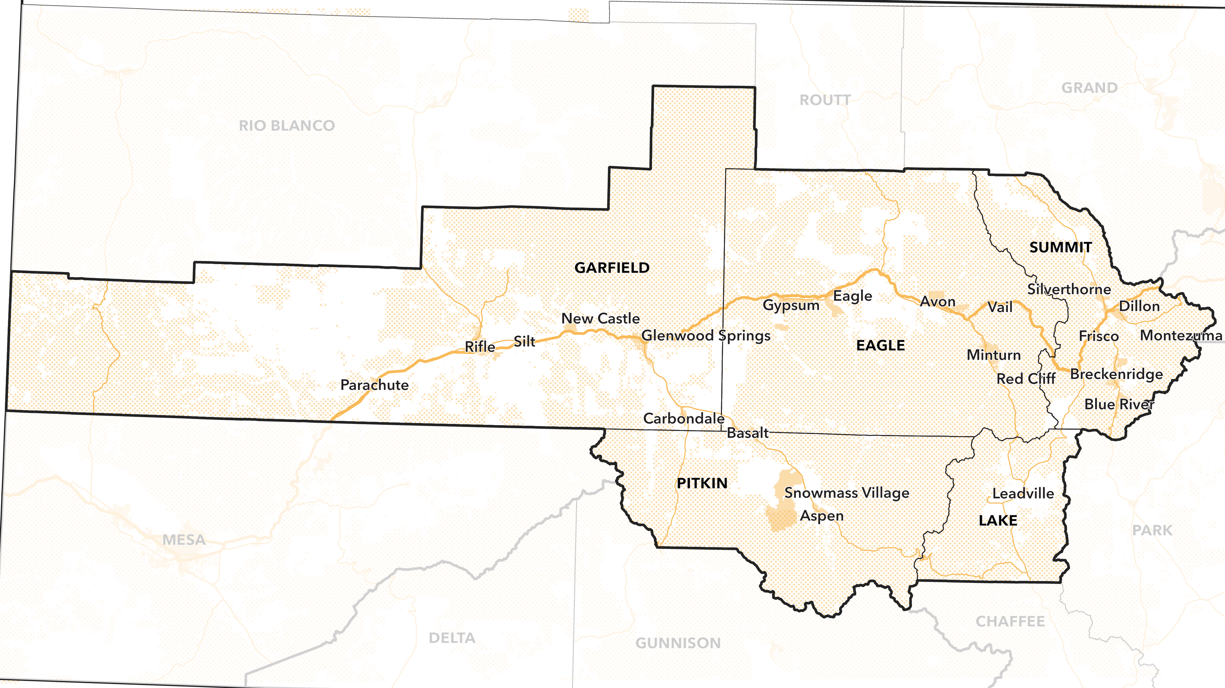
RURAL RESORT REGION
Notes:
Charlie - slides 10 - 12 - Rural Resorts - 4 min - 3:20 - 3:23
So let’s take a look at the Rural Resort region. We’ve included maps for each region to help orient folks to where in the state we’re talking about. As you can see, the counties included in this region are home to most of our mountain resort areas, like Vail, Aspen, and Breckenridge. This region is located along the I-70 corridor, the thick gold line. The dotted areas represent some type of public lands, which there are a lot of in this region. Tourism and recreation are a major part of the economy.

Slide 11
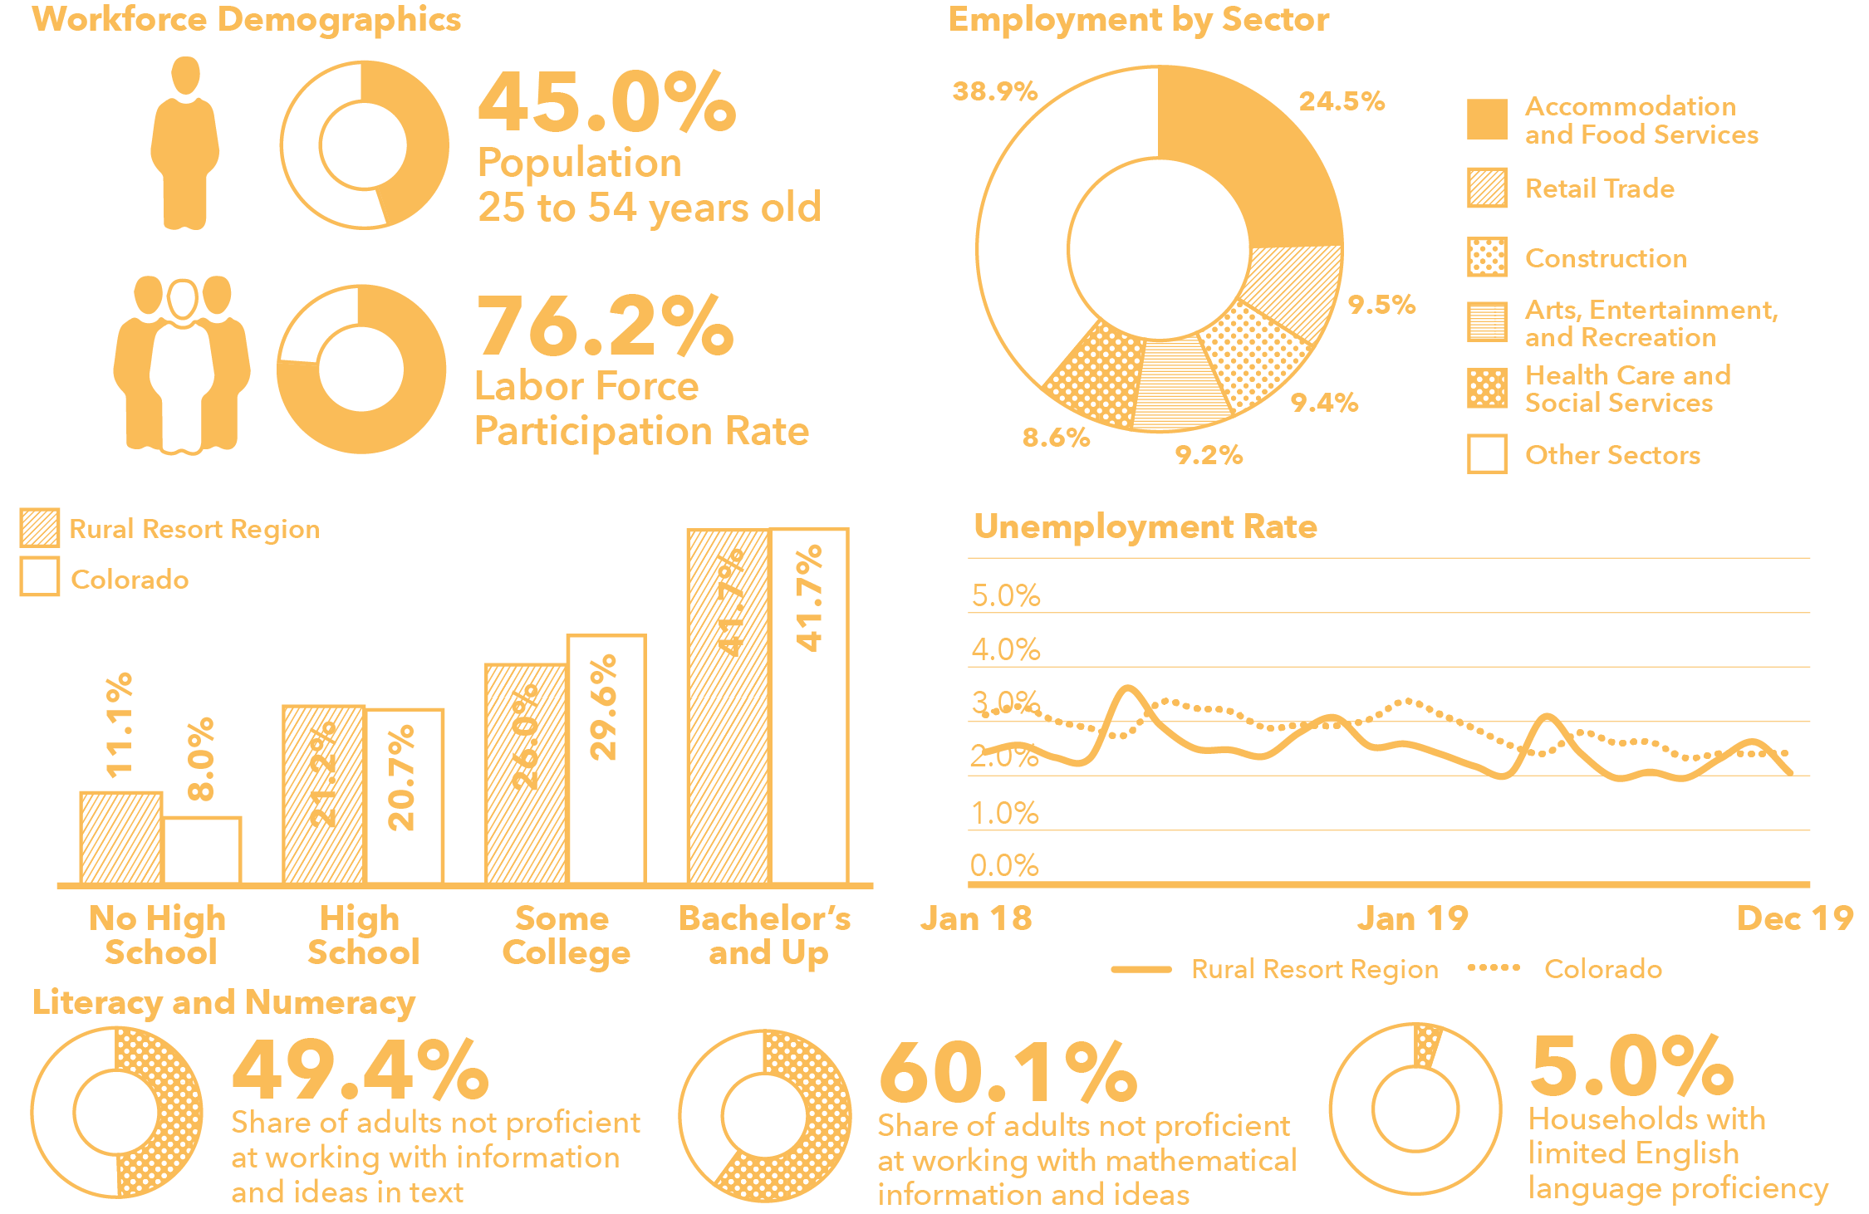
RURAL RESORT REGION: 2019
Source: 2019 5-Year American Community Survey and Quarterly Workforce Indicators, US Census; Local Area Unemployment Statistics, BLS; PIAAC, U.S Department of Education
Notes:
Now, taking a look at some data, we can see that nearly half of the population in 2019 were “prime working age”. The labor force participation rate was quite high, higher than the rate for the state as a whole. This means that a large share of the population over 16 was working or looking for work. It’s not necessarily a good or bad thing, it could reflect the high cost of living in this region and the need for all adults to work in order to afford to live in this part of the state. We can see that the rates of educational attainment largely match that of the state as a whole, although there are slightly more people with no high school education. We can also see that large share of the population is considered to be not proficient or nearing proficiency in literacy and numeracy, and 5% of households reported having limited English language proficiency. Employment is concentrated in the accommodation and food services sector, as well as other tourism-related sectors like retail trade, construction, and arts, entertainment and recreation. Looking at the unemployment rate, we can see that there are seasonal fluctuations in unemployment, with spikes in the spring and fall seasons following the winter and summer seasons.

Slide 12
RURAL RESORT REGION: 2020
February 2020 Unemployment: 2.3%
April 2020 Unemployment: 20.7%
Source: Quarterly Workforce Indicators, US Census; Current Employment Statistics and Local Area Unemployment Statistics, BLS
Notes:
through 3:23
Now looking at economic changes between February and April of 2020, we can see that nearly four in ten jobs lost in this region were in the accommodation and food services sector, followed by arts, entertainment, and recreation. Together, losses in these two sectors represented a much larger share of jobs lost than for the state as a whole. Overall, this region saw employment decline by over 30% over these two months, a much larger decline than for the state as a whole. Unemployment increased from 2.3% to 20.7%, though part of this increase was likely driven by seasonal trends in employment.

Slide 13
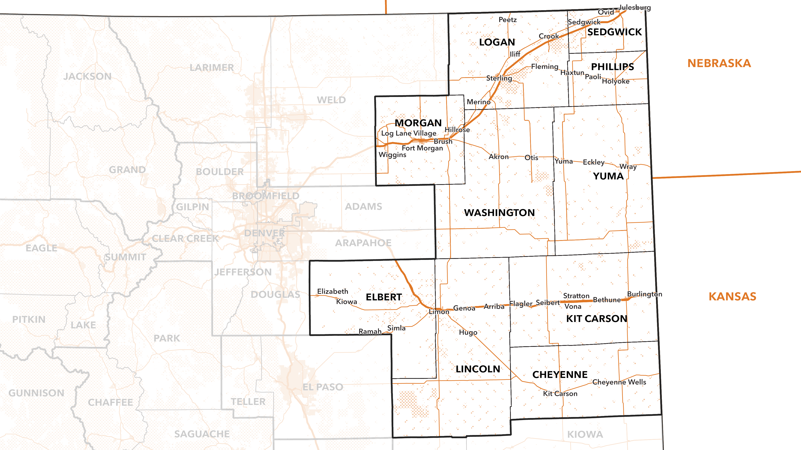
EASTERN REGION
Notes:
Charlie - slides 13, 14, 15 - 3 min through 3:26
Now let's look at the Eastern Region, the region that saw the lowest unemployment rate as of April 2020. Looking at the map we can see that this is a very large region in our state, covering most of the northeastern corner. Communities are located along transportation corridors, and the economy is much more oriented towards agriculture than in the rural resort region.

Slide 14
EASTERN REGION: 2019
Source: 2019 5-Year American Community Survey and Quarterly Workforce Indicators, US Census; Local Area Unemployment Statistics, BLS; PIAAC, U.S Department of Education
Notes:
Charlie - slides 13, 14, 15 - 4 min through 3:26
We can see that prime working age adults represented a smaller share of the population than in the rural resort region. Likewise, the labor force participation rate was lower. There are many factors that may explain this, but one in particular could be a larger share of retired Coloradans live in this area (this is common in many rural parts of our state and country). Looking at educational attainment we can see that a smaller share of the population had a bachelor's degree compared to the state as a whole. The share of adults not proficient or nearing proficiency in literacy and numeracy was greater than in the rural resort region, but there was a smaller share of households with limited language proficiency. Looking at the economy, employment was spread fairly evenly across the top five sectors, though manufacturing accounted for the largest share of employement. The unemployment rate trends lower than the statewide rate, but tends to follow the state rate closely.

Slide 15
EASTERN REGION: 2020
February 2020 Unemployment: 2.4%
April 2020 Unemployment: 5.7%
Source: Quarterly Workforce Indicators, US Census; Current Employment Statistics and Local Area Unemployment Statistics, BLS
Notes:
through 3 :26 Charlie data
Looking now to initial COVID-19 impacts, we can see that nearly half of jobs lost were in the educational services sector, compared to just 13.7% of the jobs lost in the state as a whole. Accommodation and food services accounted for the next largest share of job losses, but was much smaller than the share for the state as a whole. Employment declined by 8.3%, lower than the 15.4% seen in the state as a whole. As a result, the unemployment rate only increased by 5.7% from 2.4% in February 2020.
Laura 3 min - qualitative input from 2 regions
Local resorts - info from Dawn Bray Jenks and Jessica Valand
Eastern - info from Dawn Robards and Clarke - through 3:29

Slide 16
WHAT IS HAPPENING NOW?
A Look at Two Urban Regions:
Arapahoe/Douglas Region
Denver-Aurora-Lakewood MSA
Pueblo Region
Pueblo MSA
Notes:
Charlie - quick intro of urban regions - 1 min
3:30
Thanks for that insight Laura! Now let's turn to what's been happening in our state over the past year or so. We'll look at the experiences of two "urban" regions, Arapahoe/Douglas and Pueblo. Both are located within metropolitan statistical areas and are located along the I-25/Front Range urban corridor in our state.

Slide 17
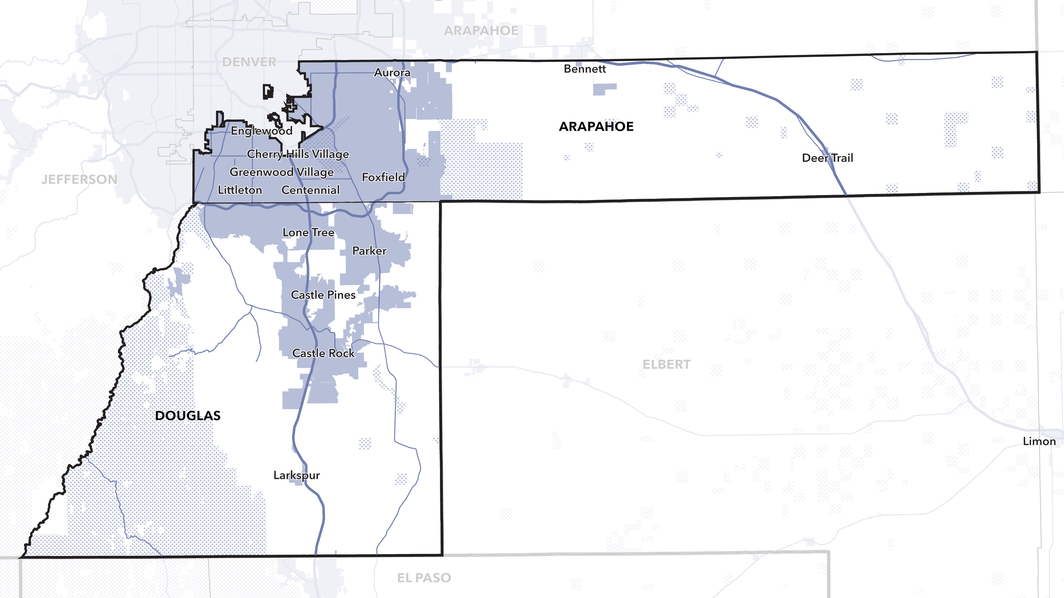
ARAPAHOE/DOUGLAS REGION: 2021
Notes:
Charlie - slides 17 -18 2 min
3:32
Looking at Arapahoe/Douglas first, we can see that this region is located in the south-eastern portion of the Denver metro areas. I-25 is a major transportation corridor running through this region, connecting Denver with Colorado Springs. Both counties in this region are notable for their diversity, with communities ranging from urban to suburban and rural as one moves away from the Denver metro area to the south and east.

Slide 18
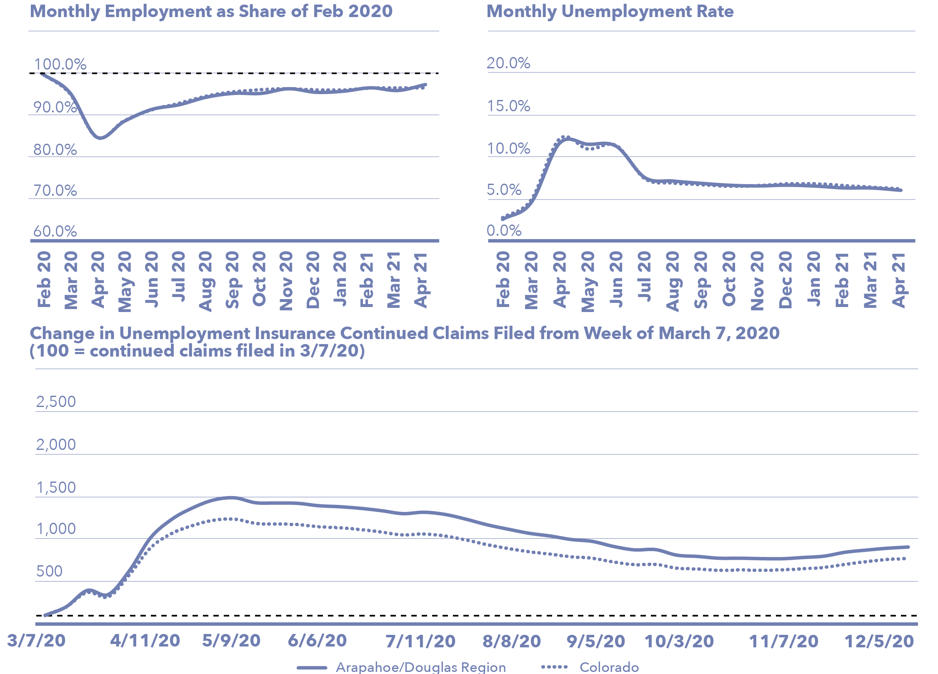
ARAPAHOE/DOUGLAS REGION: 2021
Source: Local Area Unemployment Statistics, BLS; Colorado Department of Labor and Employment
Notes:
through 3:32
Looking at trends over the past year, we can see that changes in employment roughly track with statewide trends. This region still has less employment as of April 2021 than in February 2020 so the recovery is still ongoing. Unemployment rates have also largely mirrored the statewide rate, peaking during April and then declining over the summer of 2020 before sticking around 6% through the rest of 2020 and 2021. Looking at changes in the number of continue unemployment insurance claims filed from March to December, we can see that the region has seen a greater increase in the number of claims filed than in the state as a whole, but trends in continued claims largely followed statewide trends, with the number of claims declining through out much of 2020 before increasing leading up to the end of that year.

Slide 19
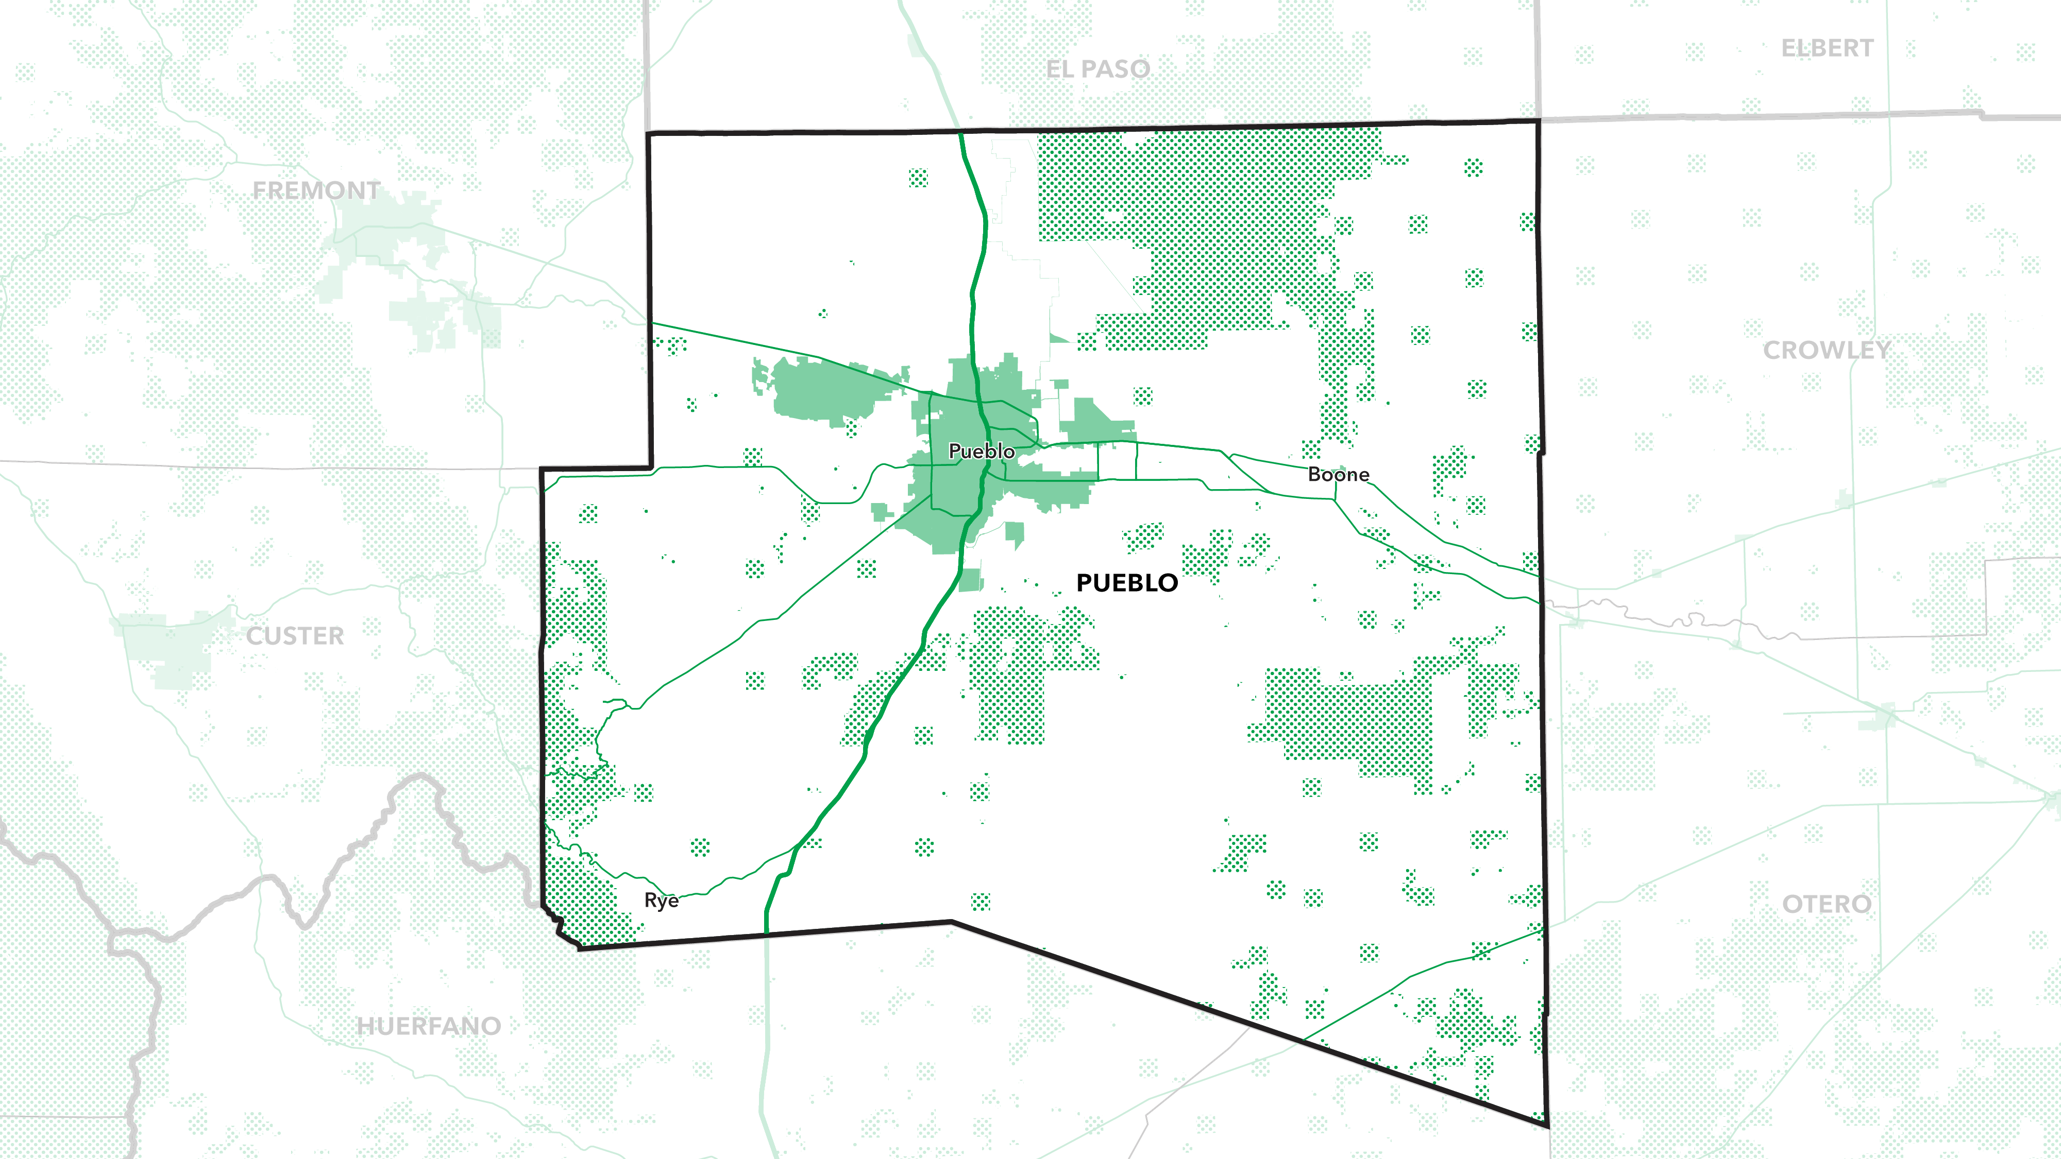
PUEBLO REGION: 2021
Notes:
Charlie - Slide 19 - 20 2 min - 3:34
Now moving on to the Pueblo region. This region includes Pueblo County, in which Pueblo is the largest city and urban area. It is located along the 1-25 corridor, south of Colorado Springs.

Slide 20
PUEBLO REGION: 2021
Source: Local Area Unemployment Statistics, BLS; Colorado Department of Labor and Employment
Notes:
Charlie through 3:34 -
As with the Arapahoe/Douglas region, trends in employment and unemployment largely follow statewide trends. However, it appears that Pueblo has seen declines in employment since November 2020, signs that the recovery is faltering in this region. Similarly the unemployment rate increased since July 2020 and is was at 8.6% in April 2021, the highest rate among our nine regions and more than 2pp above the statewide rate of 6.3%. While this region did not experience as intense of an increase in the number of people filing continue unemployment insurance claims at the outset of the pandemic, Pueblo has seen the number of people filing such claims hold stead throughout much of 2020, increasing slightly towards the end of the year.
Laura add qualitative info from Arapahoe and Douglas - Suzie and Sasha
Pueblo - Diane and Andrew Upper Arkansas - 3 min total 3:37

Slide 21
PUEBLO REGION: 2021
What are your experiences over the past 15 months in your regions, organizations and agencies?
Notes:
Laura - questions to attendees and ask Tony to read out submissions - 4 min - through 3:41
Thanks for all your input on this question. Please feel free to email us after the presentation if there is more that you would like to share (emails provided at the end of the presentation). For our next question, we will be asking you all to weigh-in on examples of current activities or momentum that is contributing to the economic recovery in your community or region of the state. Are there any new challenges? Please feel free to share your responses with us in the chat.

Slide 22
COLORADO’S POST-COVID ECONOMY
Occupational Employment Growth Projections: Colorado, 2019-29
Source: Bureau of Labor Statistics
Notes:
Charlie - 3 min - 3:44
Let’s take a look at where we think the economy is headed over the next ten years. The Bureau of Labor Statistics, in cooperation with state labor and employment departments, prepares employment projections for different occupations and sectors of teh economy. These forecasts are based largely on past trends, and so can be thrown off by unexpected shocks to the economy, such as COVID-19. Since the latest projections were released in 2019, the BLS produced two national-level scenarios to explore how COVID-19 might affect the employment outlook in different occupations. These scenarios envision different levels of remote working and automation of services and a reduction in in-person events. They were released in February, and don’t reflect the recent advances with vaccinations and lifting of many public health restrictions on the economy. However, they are still informative in terms of understanding which occupations will be most affected by trends, like telework and automation, that accelerated during the pandemic and don’t look like they will be going away soon. The chart shows the national projected changes in employment applied to Colorado’s projections for employment by occupation. These numbers shouldn’t be interpreted as exact predictions so much as indicators of how trends like telework or automation will affect employment in different occupations in the future. However, we can see that these trends could lead to and increase in employment opportunities in computer and mathematical occupations, as well as in life, physical and social science occupations. On the other hand, these trends are likely to lead to a decrease in growth in sales and related occupations, as well as food preparation and serving occupations and office and administrative support occupations. Its notable that in the sever scenario, these three occupation groups will see declines in employment over the next year. While this does not seem likely given the strong growth seen in the accommodation and food services sector, which is largely driving our employment growth in the state, however, it does signify that some of our largest occupational groups have poor employment outlooks, but also that there needs to be pathways developed in our state’s workforce development systems to help workers transition from relatively low-skill jobs in these occupations to higher-skill jobs in computer, math and science occupations.

Slide 23
OPPORTUNITIES OF INTEREST
Expanding Broadband across Colorado will create new jobs for installing and related positions (Office of the Future of Work, CDLE)
Increased types of apprenticeships will create different career pathways in new sectors, including public service (Discussion with staff at CDLE)
Parents with children at home are increasingly wanting and pursuing jobs that can be performed from home, saving on child care and transportation expenses (Interview with CWEE staff)
There are ongoing opportunities for health professionals in most regions across Colorado (Interviews with Southeast and Rural Resort subregions)
Increasing opportunities for Coloradans with justice involvement in tech and construction industries (Interviews with Justice Reskill and Community Works)
Notes:
Laura - 1 min - 3:45

Slide 24
OPPORTUNITIES OF INTEREST
Expanding Broadband across Colorado will create new jobs for installing and related positions (Office of the Future of Work, CDLE)
Increased types of apprenticeships will create different career pathways in new sectors, including public service (Discussion with staff at CDLE)
Parents with children at home are increasingly wanting and pursuing jobs that can be performed from home, saving on child care and transportation expenses (Interview with CWEE staff)
There are ongoing opportunities for health professionals in most regions across Colorado (Interviews with Southeast and Rural Resort subregions)
Increasing opportunities for Coloradans with justice involvement in tech and construction industries (Interviews with Justice Reskill and Community Works)
What are some examples of additional current activities and momentum?
Any new challenges?
Notes:
Charlie - 3 min - 3:48

Slide 25
PROMISING PRACTICES
State:
Create state Apprenticeship Office that can authorize diverse types of formal learning opportunities
Approach the issue of digital equity and inclusion as a statewide initiative
Create state-level funding positions to build capacity of small regions to procure public, private, and more flexible sources of funding
Regional:
Incentivize counties across the state to create a Municipal Broadband System with fiber service for every home
Partner with Workforce Boards and Chambers of Commerce to create apprenticeships in different emerging business sectors
Notes:
Slides 25 - 26
Laura 4 min - 3:52

Slide 26
PROMISING PRACTICES
Regional:
Establish “Pathway to the Pathway” series of apprenticeships and credentials that invite workers of diverse levels and aspirations to pursue new fields and positions
Create regional networks that are part of larger state digital coaching system--establish fieldwork opportunities with community colleges and universities to add capacity
Establish and operate career pathways for justice involved individuals and tech and construction sectors
Local:
Establish and support new training/work opportunities in human services sector through diverse workforce funding streams
Create new positions and training credentials for jobs that are emerging from the pandemic (culturally responsive health care workers)
Notes:
Through 3:51

Slide 27
RECOMMENDATIONS
Prioritize and invest in the importance and significance of digital equity in all parts of the state
Broadband and connectivity to each home (affordable and high speed), equipment and security programs, access to a flexible and responsive coaching/navigation program
Create a position at the state (perhaps CDLE) that assists workforce regions to identify and obtain diverse funding streams
Identify specific pre-apprenticeship options in rural and urban regions to develop and fund as new work pathways for workers impacted by COVID-19
Incorporate new funds from the American Rescue Plan (ARPA) into targeted opportunities for displaced workers with lower skills
Encourage employers to develop work environments that prioritize living wage pay, benefits, and predictable and flexible schedules for employees
Notes:
Slide 27
Charlie and Laura - ask for other comments too - 4 min - through 3:55
There are just a few of the recommendations
Need to add time for questions and more comments

Slide 28
NEXT STEPS
Please email any additional comments or questions to Laura and Charlie
Report launch date: Mid-July 2021
Contact information:
Charlie Brennan: cbrennan@cclponline.org
Laura Ware: lauraware985@gmail.com
Katherine Keegan: katherine.keegan@state.co.us
Clarke Becker: clarke.becker@state.co.us
CCLP: info@cclponline.org
Notes:
Laura - request for final comments and questions 3:55 - 3:59
Contact info and launch of report

Slide 29
THANK YOU!
789 Sherman Street, Suite 300
Denver, CO 80203
www.cclponline.org
Notes:
Finish - leave chat open for 5 more minutes if possible to get additional input

